Slide 1

Common Array Algorithm: Filling
Fill an array with squares (0, 1, 4, 9, 16, ...):
for (int i = 0; i < values.length; i++)
{
values[i] = i * i;
}

Slide 2
Common Array Algorithm: Maximum or Minimum
Finding the maximum in an array
double largest = values[0];
for (int i = 1; i < values.length; i++)
{
if (values[i] > largest)
{
largest = values[i];
}
}

Slide 3
Common Array Algorithm: Maximum or Minimum
Finding the minimum: reverse the comparison.
These algorithms require that the array contain at least one element.

Slide 4
Common Array Algorithm: Element Separators
Print the separator before each element except the initial one (with index 0):
for (int i = 0; i < names.length; i++)
{
if (i > 0) { System.out.print(" , "); }
System.out.print(names[i]);
}

Slide 5
Common Array Algorithm: Linear Search
To find the position of an element:
Visit all elements until you have found a match or you have come to the end of the array
Example: Find the first element that is equal to 100
int searchedValue = 100;
int pos = 0;
boolean found = false;
while (pos < values.length && !found)
{
if (values[pos] == searchedValue) { found = true; }
else { pos++; }
}
if (found) { System.out.println("Found at position: " + pos); }
else { System.out.println("Not found"); }

Slide 6

Common Array Algorithm: Linear Search
This algorithm is called a linear search.
A linear search inspects elements in sequence until a match is found.
To search for a specific element, visit the elements and stop when you encounter the match.

Slide 7
Common Array Algorithm: Removing an Element
Problem: To remove the element with index pos from the array values with number of elements currentSize.
Unordered
Overwrite the element to be removed with the last element of the array.
Decrement the currentSize variable.
values[pos] = values[currentSize - 1];
currentSize--;

Slide 8
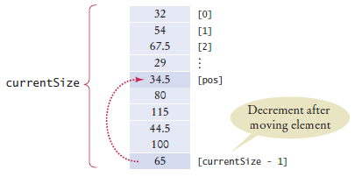
Common Array Algorithm: Removing an Element
Figure 6 Removing an Element in an Unordered Array

Slide 9
Common Array Algorithm: Removing an Element
Ordered array
Move all elements following the element to be removed to a lower index.
Decrement the variable holding the size of the array.
for (int i = pos + 1; i < currentSize; i++)
{
values[i - 1] = values[i];
}
currentSize--;

Slide 10
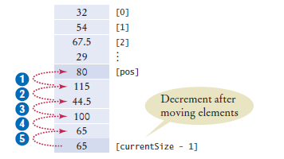
Common Array Algorithm: Removing an Element
Figure 7 Removing an Element in an Ordered Array

Slide 11
Common Array Algorithm: Inserting an Element
If order does not matter
Insert the new element at the end of the array.
Increment the variable tracking the size of the array.
if (currentSize < values.length)
{
values[currentSize] = newElement;
currentSize++;
}

Slide 12
Common Array Algorithm: Inserting an Element
If order matters Increment the variable tracking the size of the array.
Move all elements after the insertion location to a higher index.
Insert the element.
if (currentSize < values.length)
{
currentSize++;
for (int i = currentSize - 1; i > pos; i--)
{
values[i] = values[i - 1];
}
values[pos] = newElement;
}

Slide 13
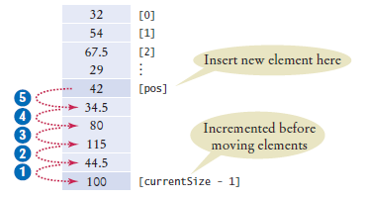
Common Array Algorithm: Inserting an Element
Figure 9 Inserting an Element in an Ordered Array

Slide 14

Common Array Algorithm: Swapping Elements
To swap two elements, you need a temporary variable.
We need to save the first value in the temporary variable before replacing it.
double temp = values[i];
values[i] = values[j];
Now we can set values[j] to the saved value.
values[j] = temp;

Slide 15
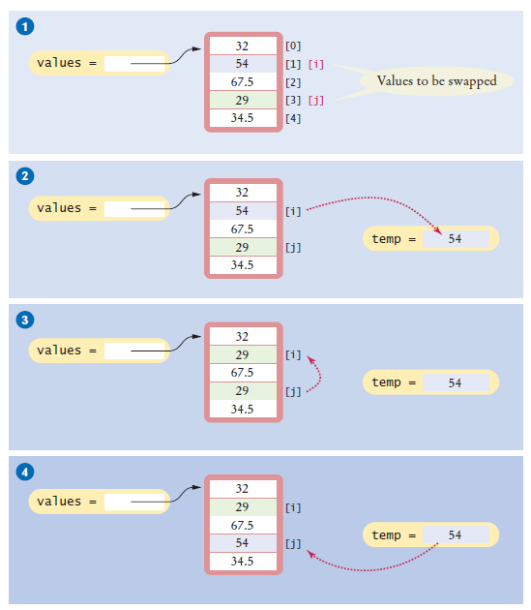
Common Array Algorithm: Swapping Elements
Figure 10 Swapping Array Elements

Slide 16
Common Array Algorithm: Copying an Array
Copying an array variable yields a second reference to the same array:
double[] values = new double[6];
. . . // Fill array
double[] prices = values;
To make a true copy of an array, call the Arrays.copyOf method:
double[] prices =
Arrays.copyOf(values, values.length);

Slide 17
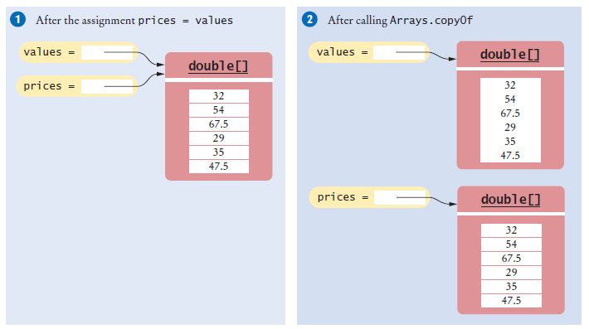
Common Array Algorithm: Copying an Array
Figure 11 Copying an Array Reference versus Copying an Array

Slide 18
Common Array Algorithm: Growing an Array
To grow an array that has run out of space, use the Arrays.copyOf method to double the length of an array
double[] newValues = Arrays.copyOf(values, 2 * values.length);
values = newValues;

Slide 19
Reading Input
To read a sequence of arbitrary length:
Add the inputs to an array until the end of the input has been reached.
Grow when needed.
double[] inputs = new double[INITIAL_SIZE];
int currentSize = 0;
while (in.hasNextDouble())
{
// Grow the array if it has been completely filled
if (currentSize >= inputs.length)
{
inputs = Arrays.copyOf(inputs, 2 * inputs.length); // Grow the inputs array
}
inputs[currentSize] = in.nextDouble(); currentSize++;
}
Discard unfilled elements.
inputs = Arrays.copyOf(inputs, currentSize);

Slide 20
Self Check 7.14
Write a loop that counts how many elements in an array are equal to zero.
Answer:
int count = 0;
for (double x : values)
{
if (x == 0) { count++; }
}

Slide 21
Self Check 7.15
Consider the algorithm to find the largest element in an array. Why don’t we initialize largest and i with zero, like this?
double largest = 0;
for (int i = 0; i < values.length; i++)
{
if (values[i] > largest) { largest = values[i]; }
}
Answer: If all elements of values are negative, then the result is incorrectly computed as 0.

Slide 22
Self Check 7.16
When printing separators, we skipped the separator before the initial element. Rewrite the loop so that the separator is printed after each element, except for the last element.
Answer:
for (int i = 0; i < values.length; i++)
{
System.out.print(values[i]);
if (i < values.length – 1)
{
System.out.print(" | ");
}
}
Now you know why we set up the loop the other way.

Slide 23
Self Check 7.17
What is wrong with these statements for printing an array with separators?
System.out.print(values[0]);
for (int i = 1; i < values.length; i++)
{
System.out.print(", " + values[i]);
}
Answer: If the array has no elements, then the program terminates with an exception.

Slide 24
Self Check 7.18
When finding the position of a match, we used a while loop, not a for loop. What is wrong with using this loop instead?
for (pos = 0; pos < values.length && !found; pos++)
{
if (values[pos] > 100) { found = true; }
}
Answer: If there is a match, then pos is incremented before the loop exits.

